Slide 1
Hop Top ~A 2D platformer game~

Slide 2
The pitch
The Idea :
2d Asymmetrical Vertical Platformer with RPG elements inspired by Jump King.
Why jump-king like ?
The design and overall feel of the game ( game atmosphere ) is cool.
What is it made in?
ThreeJs + React

Slide 3
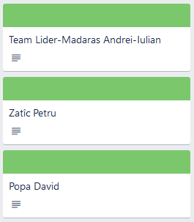
The team
Madaras Andrei Iulian
Sprite and texture creation
Programming
Game Design
Zatic Petru
Programming Lead
Game Design
Popa David
Programming
Testing
More info on Trello :
https://trello.com/invite/b/YwTXPlSp/ATTI7f8093913e05f18e8d062005aa7124d8463ED49B/proiect-pjc

Slide 4
General Idea
Synopsis
The story of the game follows a grim aftermath of the events of the game “Jump King” where the proverbial jumping hero becomes the king and , for an unknown reason , turns into an evil tyrant. You play as his forgotten son trying to peace together why he went mad and fight your way to the top just as the king once did himself.

Slide 5
Game mechanics
Jumping and player controls.
The player can move left, right with keyboard or mouse controls , and most importantly can jump , charge jump like in Jump Kind and later on with a specific item or item + power combo can double jump
Items and their power.
Items heavy effect the difficulty of the game making it easier (most of them) for the cost of having to ‘farm’ enemies or take more time finding secrets or getting treasure.
Enemies and taking “damage”.
Enemies are ai controlled , can respawn and have their own animations
Taking damage in this game is not synonymous with depleting health since you don’t have any , but it will set the player character in a “wounded state” were moving is obstructed or impossible ,taking damage also depletes item durability.

Slide 6
Level design
Asymmetric multi-stage vertical platformer.
As of the demo there are 3 areas :
[I] Forest of Lament
[II] Castle of Terror
[III] Top of the World

Slide 7
Item design
Player Items
2 categories :
boots
helmet
boots : - durability
- sturdiness ( ~armor against traps )
- charge speed
- jump height
*special adaptability ( better control on slippery surfaces )
helmets : - durability
- poise ( knockback res)
- armor ( lessens stun duration on taking damage )

Slide 8
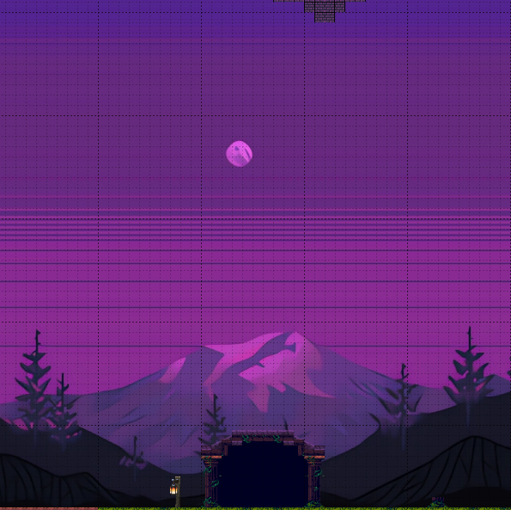
Environment design
First Area : Forest of lament

Slide 9
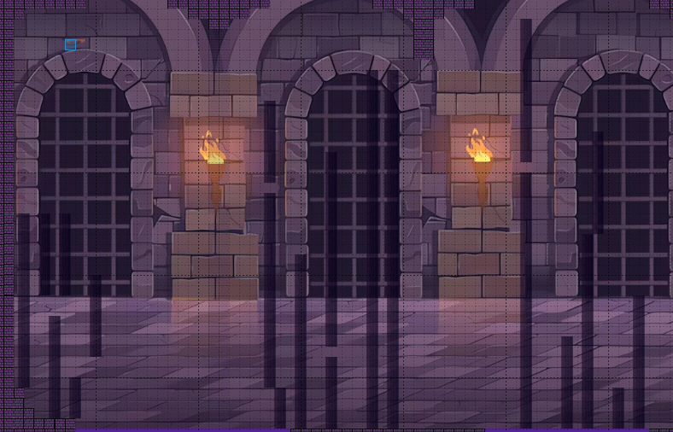
Environment design
Second Area : Castle of Terror

Slide 10
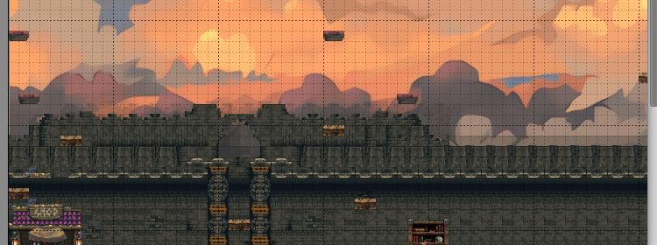
Environment design
Third Area : Top of the world

Slide 11
Art and sprites
Art made with StableDiffusion + ControlNet
Various tools for spriting
Tile Packs from Itchio
All credits found on Trello Page

Slide 12
The end

